Slide 1
Software Quality Management
Subhash Paudel
MSCSKE, IOE, Pulchowk Campus
subhash@achsnepal.edu.np
Notes:
M.Sc. Computer Engineering, Computer System and Knowledge Engineering

Slide 2
Software Quality Management
While quality is generally agreed to be ‘a good thing’ , in practice what people really mean by the ‘quality’ of a system can be vague.
We therefore need to define precisely what qualities we require of a system
However this is not enough- we need to judge objectively whether a system meets our quality requirements and this need measurement
Involves the definition of appropriate quality standards and the definition of procedures to ensure that these standards are followed
Works best when a ‘quality culture’ is created where quality if seen as everyone’s responsibility

Slide 3
Software Quality Management
Quality means that a product satisfies the demands of its specifications
It also means achieving a high level of customer satisfaction with the product
In software systems this is difficult
customer quality requirements (e.g. efficiency or reliability) often conflict with developer quality requirements (e.g. maintainability or reusability)
software specifications are often incomplete, inconsistent, or ambiguous

Slide 4
Software Quality Management
Quality
Time
Cost
Scope/ Requirement
Fig: Project Management Triangle/ Iron Triangle/ Quality Triangle

Slide 5
Total Quality Management (TQM)
TQM is an approach to improving the effectiveness and flexibilities of business as a whole
It is essentially a way of organizing and involving the whole organization, every department, every activity and every single person at every level
TQM ensures that the management adopts a strategic overview of the quality and focuses on prevention rather than inspection
It encourages innovation, makes the organization adaptable to change, motivates people for better quality

Slide 6
Objectives of TQM
Meeting the customer's requirements is the primary objective and the key to organizational survival and growth.
The second objective of TQM is continuous improvement of quality. The management should stimulate the employees in becoming increasingly competent and creative.
Third, TQM aims at developing the relationship of openness and trust among the employees at all levels in the organization.

Slide 7
Elements of TQM
Be customer focused It requires the company to check customers' attitudes regularly and includes the idea of internal customers as well as external ones.
Do it right the first time This means avoiding rework, i.e., cutting the amount of defective work.
Constantly improve Continuous improvement allows the company gradually to get better.
Quality is an attitude Every one has to be committed to quality. That means changing the attitude of the entire workforce, and altering the way the company operates.

Slide 8
Elements of TQM
Telling staff what is going on This involves improved communication. Typically, it includes team briefing.
Educate and train people An unskilled workforce makes mistakes. Giving more skills to workers means they can do a wider range of jobs, and do them better.
Measure the work. Measurement allows the company to make decisions based on facts, not opinion. It helps to maintain standards and keep processes within the agreed tolerances.
Top management must be involved If senior management is not involved, the programme will fail.

Slide 9
Elements of TQM
Make it a good place to work Staffs are afraid of the sack, their boss and making mistakes. There is no point in running a TQM program unless the company drives out fear.
Introduce team work Team work boosts employees' morale. It reduces conflict and solves problem by hitting them with a wider range of skills. It pushes authority and responsibility downwards and provides better, more balanced solutions.
Organize by process, not by function This element of TQM seeks to reduce the barriers that exist between different departments, and concentrates on getting the product to the customer.

Slide 10
TQM Fails Because
Top management sees no reason for change.
Top management is not concerned for its staff.
Top management is not committed to the TQM programme.
The company loses interest in the programme after six months.
The workforce and the management do not agree on what needs to happen.

Slide 11
The Importance Of Software Quality
Increasingly criticality of software: The final customer or user is naturally anxious about the general quality of software.
The intangibility of software : This makes it difficult to know that a particular task in a project has been completed satisfactory.
Accumulating errors during software development : As computer system development is made up of a number of steps where the output from one step is the input to the next steps, the error in the earlier deliverable will be added to those in the later step, leading to an accumulating detrimental effect.

Slide 12
Defining Software Quality
Conformance to requirements: The project’s processes and products meet written specifications
Fitness for use: A product can be used as it was intended
For any software system there should be three specification
Functional specification describing what the system is to do
Quality specification concerned with how well the function are to operate
Resource specification concerned with how much is to be spent on the system

Slide 13
Defining Software Quality
When there is concerned about the need for a specific quality characteristics in a software product then a quality specification with the following minimum details should be drafted
Definition/description : definition of the quality characteristics
Scale : the unit of measurement
Minimally acceptable : the worst value which might be acceptable if other characteristics compensated for it, and below which the product would have to be rejected out of hand
Target range: the range of values within which it is planned the quality measurement
Now: the value that applies currently

Slide 14
Quality Management Activities
Quality planning (Planning)
selecting and modifying applicable quality standards and procedures for a particular project
Quality assurance (Executing)
establishing organizational quality standards and procedures
Quality control (Monitor/Control)
ensuring quality standards and procedures are followed by development team
Note: Quality management should be separated from project management to ensure independence.

Slide 15
Quality Management And Software Development

Slide 16
Process And Product Quality
The quality of a developed product is influenced by the quality of the production process.
This is important in software development as some product quality attributes are hard to assess.
However, there is a very complex and poorly understood relationship between software processes and product quality.

Slide 17
Process Based Quality

Slide 18
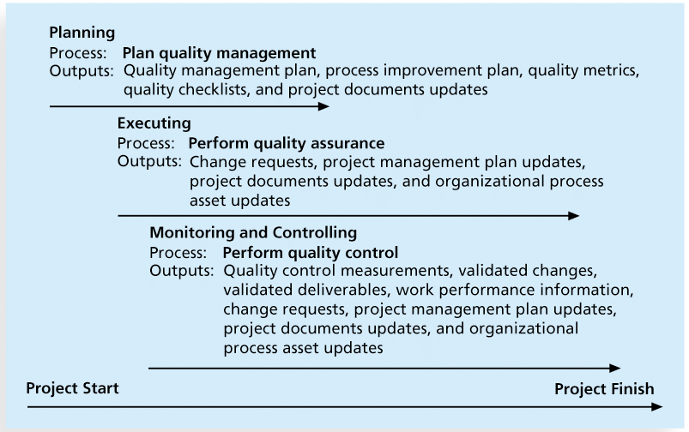
Project Quality Management Summary

Slide 19
Quality Planning
A quality plan sets out the desired product qualities and how these are assessed and defines the most significant quality attributes.
The quality plan should define the quality assessment process.
It should set out which organisational standards should be applied and, where necessary, define new standards to be used.

Slide 20
Quality Plans
Quality plan structure
Product introduction;
Product plans;
Process descriptions;
Quality goals;
Risks and risk management.
Quality plans should be short, briefly and clearly expressed documents
If they are too long, no-one will read them.

Slide 21
Quality Assurance And Standards
Standards are the key to effective quality management.
They may be international, national, organizational or project standards.
Product standards define characteristics that all components should exhibit e.g. a common programming style.
Process standards define how the software process should be enacted.

Slide 22
Importance of standards
Encapsulation of best practice- avoids repetition of past mistakes.
They are a framework for quality assurance processes - they involve checking compliance to standards.
They provide continuity - new staff can understand the organisation by understanding the standards that are used.

Slide 23
Component of Quality Assurance
Software Configuration Management
Software Testing
Quality Control

Slide 24
Component of Quality Assurance
1- Software Testing (Verification/Validation)
Is a popular risk management strategy and it is used to verify that the functional requirements were met.
The verification effort takes less time and is less complex when conducted throughout the development process
2- Quality Control
Is defined as a processes and methods used to monitor work and observe whether requirements are met.
Focuses on reviews and removal of defects before shipment of the products.
Responsible of the group who build the product.
Designed to detect and correct defects in all program life cycle.

Slide 25
Component of Quality Assurance
3- Software Configuration Management
Is concerned with labeling, tracking, and controlling changes in the software elements of a system. It controls the evolution of a software system by managing versions of its software components and their relationships.
Elements of Software Configuration Management
Component Identification
Version Control
Configuration Building
Change Control
Quality Control

Slide 26
Software Testing
Many IT professionals think of testing as a stage that comes near the end of IT product development
Testing should be done during almost every phase of the IT product development life cycle
Types of Testing
Unit testing tests each individual component (often a program) to ensure it is as defect-free as possible
Integration testing occurs between unit and system testing to test functionally grouped components
System testing tests the entire system as one entity
User acceptance testing is an independent test performed by end users prior to accepting the delivered system

Slide 27
Testing Alone Is Not Enough
Testing does not sufficiently prevent software defects because:
The number of ways to test a complex system is huge
Users will continue to invent new ways to use a system that its developers never considered

Slide 28
Who’s Responsible for the Quality of Projects?
Project managers are ultimately responsible for quality management on their projects
Several organizations and references can help project managers and their teams understand quality
International Organization for Standardization (www.iso.org)
IEEE (www.ieee.org)
Software Engineering Institute (SEI)
Project Management Institute (PMI)

Slide 29
Quality Control
This involves checking the software development process to ensure that procedures and standards are being followed.
There are two approaches to quality control
Quality reviews;
Automated software assessment and software measurement.

Slide 30
Quality Reviews
This is the principal method of validating the quality of a process or of a product.
A group examines part or all of a process or system and its documentation to find potential problems.
There are different types of review with different objectives
Inspections for defect removal (product);
Reviews for progress assessment (product and process);
Quality reviews (product and standards).

Slide 31
Six Sigma Analysis
Six Sigma is a process that makes use of statistics and data analysis to analyze and reduce errors or defects
Six Sigma is uniquely driven by close understanding of customer needs, disciplined use of facts, data, and statistical analysis, and diligent attention to managing, improving, and reinventing business processes
Six Sigma is a very clever way of branding and packaging many aspects of Total Quality Management (TQM)

Slide 32
Basic Information on Six Sigma
The target for perfection is the achievement of no more than 3.4 defects per million opportunities
Six Sigma is a set of management tools and techniques designed to improve the capability of the business process by reducing the likelihood of error
The principles can apply to a wide variety of processes
Six Sigma projects normally follow a five-phase improvement process called DMAIC

Slide 33
DMAIC
DMAIC is a systematic, closed-loop process for continued improvement that is scientific and fact based
DMAIC stands for:
Define: Define the problem/opportunity, process, and customer requirements
Measure: Define measures, then collect, compile, and display data
Analyze: Scrutinize process details to find improvement opportunities
Improve: Generate solutions and ideas for improving the problem
Control: Track and verify the stability of the improvements and the predictability of the solution

Slide 34
How is Six Sigma Quality Control Unique?
It requires an organization-wide commitment.
Focus on the Customer
Focus on Training, Ensure a Flexible and Responsive Ecosystem
Six Sigma organizations have the ability and willingness to adopt contrary objectives, such as reducing errors and getting things done faster
It is an operating philosophy that is customer focused and strives to drive out waste, raise levels of quality, and improve financial performance at breakthrough levels

Slide 35
Six Sigma Projects Use Project Management Tools
The training for Six Sigma includes many project management concepts, tools, and techniques
For example, Six Sigma projects often use business cases, project charters, schedules, budgets, and so on
Six Sigma projects are done in teams; the project manager is often called the team leader, and the sponsor is called the champion

Slide 36
Six Sigma Projects Use Project Management Tools
Cause and Effect Analysis
Flow Chart
Pareto Chart
Histogram
Check Sheet
Scatter Plot
Control Chart
Notes:
Pareto Chart –Bar Chart arranged with longest bars on the left and the shortest to the right; the length of the bar represent frequency or cost
Histogram-commonly used graph to show frequency distributions
Control Chart-a graph used to study how a process changes over time

Slide 37
Six Sigma and Statistics
The term sigma means standard deviation
Standard deviation measures how much variation exists in a distribution of data
Standard deviation is a key factor in determining the acceptable number of defective units found in a population
Six Sigma projects strive for no more than 3.4 defects per million opportunities, yet this number is confusing to many statisticians

Slide 38
Six Sigma Uses a Conversion Table
Using a normal curve, if a process is at six sigma, there would be no more than two defective units per billion produced
Six Sigma uses a scoring system that accounts for time, an important factor in determining process variations
Yield represents the number of units handled correctly through the process steps
A defect is any instance where the product or service fails to meet customer requirements
There can be several opportunities to have a defect

Slide 39
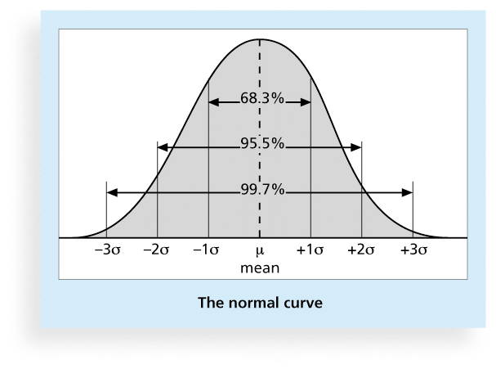
Normal Distribution and Standard Deviation

Slide 40
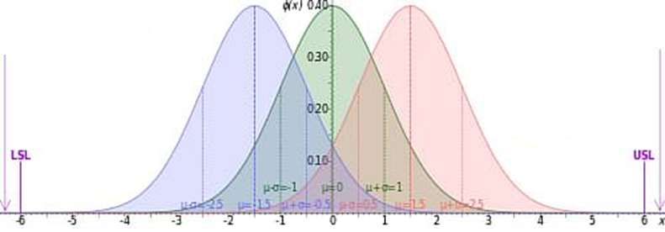
Normal Distribution and Standard Deviation

Slide 41
Sigma and Defective Units
Specification Range (in plus or minus Sigmas) | Percent of population within Range | Defective Units per Billion
1 | 68.27 | 317,300,000
2 | 95.45 | 45,400,000
3 | 99.73 | 2,700,000
4 | 99.9937 | 63,000
5 | 99.999943 | 57
6 | 99.9999998 | 2

Slide 42
Sigma Conversion Table
Sigma | Yield | Defects per Million Opportunities (DPMO)
1 | 31.0% | 690,000
2 | 69.2% | 308,000
3 | 93.3% | 66,800
4 | 99.4% | 6,210
5 | 99.97% | 230
6 | 99.99966% | 3.4
DPMO=2,700,000×(1−Φ(Z))
DPMO is the Defects Per Million Opportunities,
Z is the Z-score corresponding to the Sigma Level
Φ(Z) is the cumulative distribution function of the standard normal
distribution, representing the probability that a standard normal random
variable is less than or equal to Z.

Slide 43
ISO 9126
ISO 9126 standards was first introduced in
1991 to tackle the question of the definition
of software quality
THE ORIGINAL 13 page document was designed as a foundation upon which further more detailed standard could be built.
ISO9126 documents are now very lengthy
•
•
•

Slide 44
ISO 9126
Motivation might be-
•
Acquires: who are obtaining software from external suppliers
•
Developers: who are building a software
product
Independent evaluator: who are accessing the quality of a software product, not for themselves but for a community of user
•

Slide 45
ISO 9126
ISO 9126 also introduces another type of
•
elements – quality in use- for
which
following
element has been
Effectiveness
Productivity
Safety
Satisfaction
identified
•
•
•
•

Slide 46
ISO 9126
ISO 9126 identifies
characteristics
six
major
software
quality
•
•
•
•
•
•
Functionality
Reliability
Usability
Efficiency
Maintainability
portability

Slide 47
ISO 9126
•
Once the requirements
for the software product
have been established, the following steps are
suggested
Judge the importance of each quality characteristic for the application
Select the external quality measurements within the ISO 9126 framework relevant to the qualities prioritized
Many measurement onto ratings that reflect user satisfaction
•
•
•

Slide 48
PRACTICAL SOFTWARE QUALITY MEASURES
•
Each project needs to devise its own measures to
meet its specific need
•
The measures described relate
software products of a project
to
the
final
✓ Reliability
✓ Availability
✓ Mean time between failures
✓ Failure on demands
✓ Support activity

Slide 49
PRACTICAL SOFTWARE QUALITY MEASURES
Maintainability
A key component of this is changeability which
relates to the ease with which software can be
modified
Maintainability is changeability plus new quality,
analyzability
•
•
Extendibility
•
it has two aspects one is ease with which existing
code can be changed while another could be the
ease with which new functionality can be added

Slide 50
PRODUCT VERSUS PROCESS QUALITY
MANAGEMENT
Product Quality:
Product is according to the specifications gathered by business Analyst
bug free
Process Quality:
Process adopted by the company to test the application should be defined well enough
It should covers all the aspect of the application

Slide 51
PRODUCT VERSUS PROCESS QUALITY
MANAGEMENT
The system development process is made up of a
number of activities that are linked together so that
the output from one activity is the input to the next.
Thus program testing will depend on there being a program to test which will be the deliverable from the program coding stage.
Error can enter the process at any stage.
They can either be introduced because of a defect in
the way a process is carried out, as when the software
developers make mistakes in the logic of their
software.
•
•
•
•

Slide 52
PRODUCT VERSUS PROCESS QUALITY
MANAGEMENT
Error that creep in the early stages are more expensive
to correct at later stages for the following reasons
The later the error is found , the more rework at more
stages of development will be needed
The general tendency is for each successive stage of
development to be more detailed and less capable to
absorb change.
Following process requirements should be specified
Entry requirement
Implementation requirement
Exit requirement
•
•
•
•

Slide 53
EXTERNAL STANDARDS
BS EN ISO 9001:200
The standard is built on a foundation of the following principles
•
Understanding by an organization of the need of their customer so that
they can meet or even exceed those requirements
Leadership to provide the unity of purpose and direction needed to
achieve quality objective
Involvement of staff at all level
A focus on individual process which create intermediate or deliverable
product & service
A focus on the system of interrelated processes that create delivered
product & services
Continuous improvement of the process
Decision making based on factual evidence
Building mutually beneficial relationships with suppliers
•
•
•
•
•
•
•

Slide 54
EXTERNAL STANDARDS
ISO 15504
•
ISO/IEC 15504 is a standard for process
assessment that shares many concepts with
CMMI
The two standard should be compatible
Like CMMI the standard is designed to provide guidance on the assessment of software development process
•
•

Slide 55
TECHNIQUES TO HELP ENHANCE
SOFTWARE QUALITY
Three main themes emerge
•
✓Increasing visibility
✓Procedure structure
✓Checking intermediate stages

